Slide 1


Components
Props, Emitting Events, Slots
SoftUni Team
Technical Trainers
Software University
https://softuni.bg

Slide 2
Table of Contents
Components Overview
Props
Emitting Events
PropTypes
Slots
Dynamic Components
2

Slide 3
Have a Question?
sli.do #vue-js

Slide 4
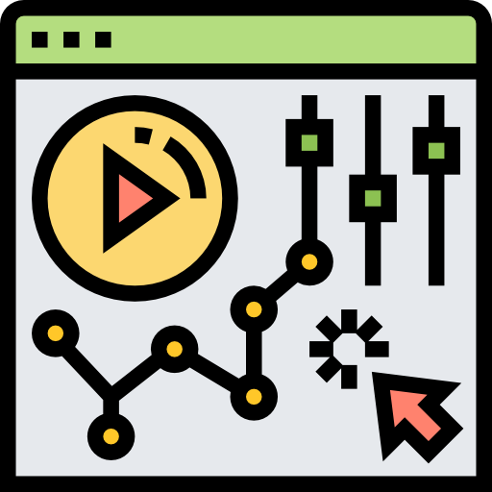
Components Overview
Declaration, Reusability, Data

Slide 5
What is a Component?
Components are reusable Vue instances with a name (selector)
They have data, computed, methods, watch properties
Each component is designed to be as simple as possible
Split the application into multiple components
Header, Footer, Navigation, Product List, Product Item
5

Slide 6
Component Declaration
Each component must be first registered
Locally or Globally
Has a unique selector which starts with app-
The data must be a function which returns an object literal
The template of the component can be:
Inline - a property inside the instance
External - inside the <template> tag of the .vue files (Vue CLI)

Slide 7
Declaration
Vue.component('app-counter', {
data: function() {
return {
counter: 0
}
},
template: '<button @click="counter++"> Counter: {{ counter }}
</button>'
});
7

Slide 8
Selector
Use the selector inside the template like an HTML tag
<div id="app">
<h1>Components</h1>
<app-counter></app-counter>
</div>
new Vue({
el: '#app'
});
The root instance is empty
8

Slide 9
Reusing Components
Components can be reused as many times as you want
Each component maintains it's own state
<div id="app">
<app-counter></app-counter>
<app-counter></app-counter>
<app-counter></app-counter>
<app-counter></app-counter>
</div>
9

Slide 10
Component Data
The data option must be a function
Each instance maintains an independent copy of the data
data: function () {
return {
count: 0,
items: [ 'First', 'Second', 'Third' ]
}
}
10

Slide 11

Props
Communication – Parent to Child

Slide 12
Props
Components communicate with each other all the time (pass data)
To pass data from a parent to a child component - use props
Custom attributes
Value of a prop is received from the parent
Should NOT be mutated
Data flows one-way
12

Slide 13
Passing Down Data
To pass down a prop use v-bind or the shorthand ":"
<post-item
v-for="post in posts"
v-bind:key="post.id"
v-bind:title="post.title"
></post-item>
Unique identifier for an item
13

Slide 14
Receiving Data
Each component instance has a "props" option
It can be an array of strings
After it has been passed it becomes a property of that instance
<script>
export default {
props: [ 'title' ]
}
</script>
14

Slide 15
Props Mutation
Props are meant to be read-only
Data flows one-way
export default {
props: [ 'title' ],
methods: {
changeTitle() {
this.title = 'New';
}
} }
Throws an error on the console
15

Slide 16
Props Naming
HTML attribute names are case-insensitive
Vue.component('blog-post', {
// camelCase in JavaScript
props: [ 'postTitle' ],
template: '<h3>{{ postTitle }}</h3>'
});
// kebab-case in HTML
<blog-post post-title="hello!"></blog-post>
16

Slide 17

Emitting Events
Communication – Child to Parent

Slide 18
Emitting Events
Sometimes communicating back up to the parent is required
Vue provides a custom event system to achieve this
Call the $emit function inside the child to create a custom event
The parent receives a notification about the custom event with v-on or the shorthand "@"
18

Slide 19
Emitting Custom Events
Vue.component('app-post-item', {
props: [ 'counter' ],
methods: {
increase() {
this.$emit('onIncrease', this.counter + 1);
}
},
template: `<button @click="increase()">Increase</button>`
};
Custom Event Name
Emitted Value
19

Slide 20
Handling Custom Events
Handle the event inside the parent component
<div>
<h1>{{ counter }}</h1>
<app-post-item
:counter="counter"
@onIncrease="counter = $event">
</app-post-item>
</div>
The Emitted Value (counter + 1)
20

Slide 21

Prop Types
List of Types, Default Values, Validator

Slide 22
Validating Props
So far, we've only seen props listed as an array of strings
Usually though, you'll want every prop to be a specific type of value
Prop Types are a really simple way to catch a lot of potential errors
They let you describe what types of values your component is expecting for each prop
22

Slide 23
Type Checking Props
To type check your props use an object instead of an array
// Parent Component
<app-container :quotesCount="11" :username="Peter">
</app-container>
// Child Component
props: {
username: String,
quotesCount: Number
}
23

Slide 24
List of Prop Types
The valid types you can use are:
String, Number, Boolean, Array,
Object, Date, Function, Symbol
When a type mismatches, VueJS alerts (in development mode) in the console with a warning
This is NOT a compile time error
24

Slide 25
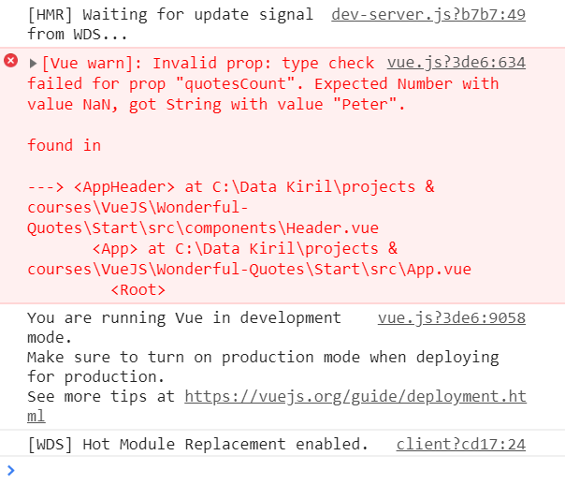
Props Type Error Example
Pass a String instead of a Number
25

Slide 26
Multiple Value Types
A prop can have multiple value types
Not recommended in most cases
Keep prop types as strict as possible!
props: {
counter: {
type: [ String, Number ]
}
}
26

Slide 27
Mandatory Prop
Along with adding types to your props, you can also specify if the prop is required or not
props: {
birthday: {
type: Date,
required: true
}
}
27

Slide 28
Default Value
As a rule, if a prop isn't required, it should have a default value
Forgeting to pass a prop will assign the default
props: {
birthday: {
type: Date,
default: new Date('July 10, 1856')
}
}
28

Slide 29
Validators
Verify array types using a validator
Returns true/false based on the custom validation
quotes: {
type: Array,
validator: (arr) => {
return arr.every(q => typeof q === 'string')
}
}
Validates an array of strings
29

Slide 30

Slots
Passing Content, Named & Scoped Slots

Slide 31
Slots – Definition
Passing data with props can be harsh when:
The properties are a lot
You need to pass HTML between components
Slots serve as distribution outlets for content
Inspired by Web Components
Similar to React's children prop and Angular's <ng-content>
31

Slide 32
Passing Content with Slots
Pass HTML between the opening and closing tag
Data is stored inside the parent component
<app-profile>
<h1>This is the profile page</h1>
<p>Username: {{ username }}</p>
<p>Email: {{ email }}</p>
<p>Age: {{ age }}</p>
</app-profile>
32

Slide 33
Rendering the Slot
To render the HTML passed from the parent simply use the <slot> tag
<template>
<div class="row">
<slot></slot>
</div>
</template>
33

Slide 34

Slot Compilation
The slot does NOT have access to the parent's data
It has the same "scope" as the rest of the template
As a rule remember:
Everything in the parent template is compiled in parent scope
Everything in the child template is compiled in the child scope
<slot> {{ username }} </slot>
34

Slide 35
Named Slots
There are times when it's useful to have multiple slots
For example with a base layout – header, main, footer
Slots can be named using an attribute
<app-profile>
<h1>This is the profile page</h1>
<p slot="username">Username: {{ username }}</p>
<p slot="email">Email: {{ email }}</p>
<p slot="age">Age: {{ age }}</p>
</app-profile>
35

Slide 36
Named Slots
Render only some of the named slots (or all of them)
<div class="row">
<template>
<slot name="username"></slot>
</template>
<template>
<slot name="email"></slot>
</template>
</div>
36

Slide 37
Default Slot
Unnamed slots are also rendered
Everything without the "slot" attribute is rendered as a default
// Parent
<h1>This is the profile page</h1>
// Child
<template>
<slot></slot>
</template>
37

Slide 38
Scoped Slots
Sometimes, it's useful for slot content to have access to data only available in the parent component
Make content available in the child component
Use v-bind on the slot itself
Also called slot props
38

Slide 39
Scoped Slots Example
// The Child
<span>
<slot v-bind:user="user">
{{ user.lastName }}
</slot>
</span>
// The Parent
<current-user>
{{ user.firstName }}
</current-user>
39

Slide 40
Props vs Slots
Slots
Good when dealing with a lot of variables and HTML
Pass other components
Component becomes more readable and less confusing
Props
Good only for passing fewer data
Cannot pass other components
Component can become hectic
40

Slide 41

Dynamic Components
Switch Between Components

Slide 42
Dynamic Components
Switching between components dynamically is possible and useful in some cases like:
Loading different components by clicking on buttons
Rendering components conditionally without using v-if
Placed inside the <component> tag
Container for dynamic components
42

Slide 43
The Component Tag
The tag takes a string (or component definition) :is prop
<button @click="selectedComponent = 'appQuote'">Quote</button>
<button @click="selectedComponent = 'appAuthor'">Author</button>
<button @click="selectedComponent = 'appNew'">New</button>
<component :is="selectedComponent">
<h1>Default Title</h1>
</component>
The component selector
43

Slide 44
Reactive Switch
Reactively switch between components with computed properties
dynamicComponent() {
if(this.isLoaded) {
return 'component-special';
} else {
return 'component-default';
}
}
44

Slide 45
Maintaining State
Components are destroyed when switched
They are re-created and added again inside the tag
Use the <keep-alive> component to maintain state
<keep-alive>
<component :is="selectedComponent">
<h1>Default Title</h1>
</component>
</keep-alive>
45

Slide 46

Summary
…
…
…
Components are reusable Vue instances
Props are used to pass down data
Emitting custom events
Prop types using validator
Passing content with Slots
Dynamic components

Slide 47
Questions?
Notes:
47

Slide 48












SoftUni Diamond Partners

Slide 49




SoftUni Organizational Partners

Slide 50
Trainings @ Software University (SoftUni)
Software University – High-Quality Education, Profession and Job for Software Developers
softuni.bg, softuni.org
Software University Foundation
softuni.foundation
Software University @ Facebook
facebook.com/SoftwareUniversity
Software University Forums
forum.softuni.bg
50
Notes:
50

